Slide 1
TOPOLOGICAL SORT

Slide 2
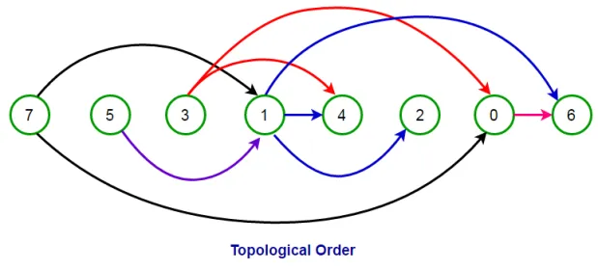
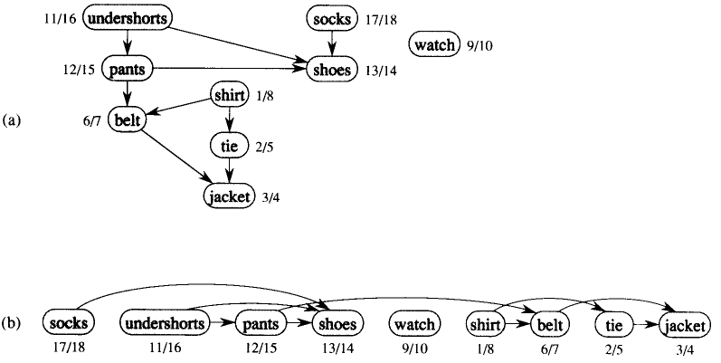

Slide 3
Why like that?
What is it?
An ordering of nodes based on which came before which in a directed graph
Whats it look like?
0 2 3 1 5 4
2
3
1
= 2 3 1

Slide 4
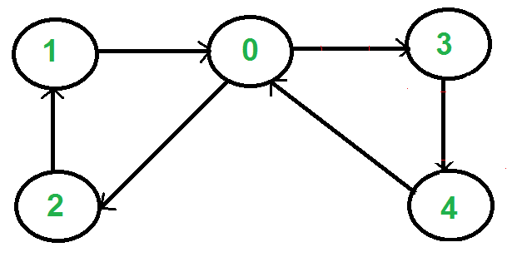
PROBLEM 1: DIRECTED AND ACYCLIC

Slide 5
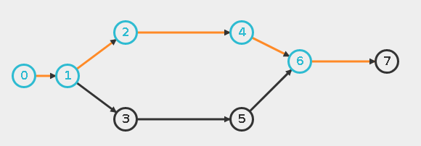

PROBLEM 2: ABOUT ORDER, NOT DEPTH
WHAT I EXPECTED
WHAT I GOT
0 1 2 3 4 5 6 7
0 1 3 5 2 4 6 7

Slide 6
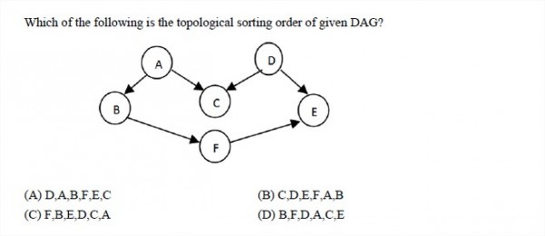
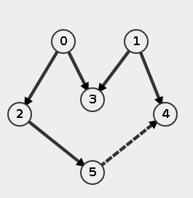
PROBLEM 3: THERE CAN BE MULTIPLE TOPOLOGICAL SORTS FOR ONE GRAPH
A) 1 0 2 5 4 3

Slide 7
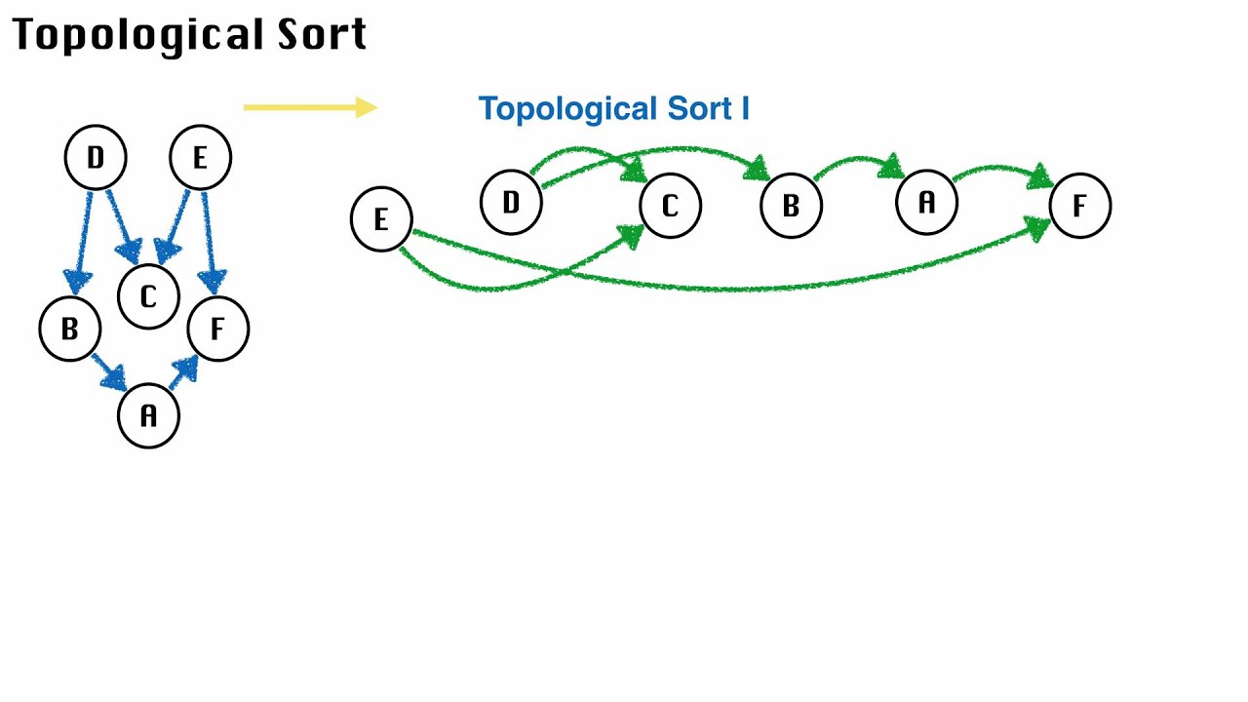
PROBLEM 3: THERE CAN BE MULTIPLE TOPOLOGICAL SORTS FOR ONE GRAPH
A) 1 0 3 2 5 4

Slide 8


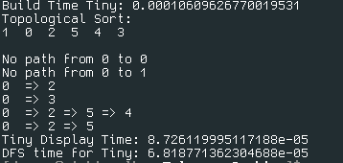
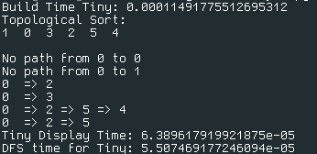

Slide 9
TL;DR
Keep a list of nodes (integers) for topological.
At the end of each DFS Visit, insert node name to beginning of said list.
Don't worry about time

Slide 10
